Slide 1
Introduction to NXT
U1C2

Slide 2
1.2.2 Introduction to NXT
Overview:
The goal of this lesson is to transition from discussing robots in general to the specifics of NXT robot.
Objectives:
Students will be able to:
1. Name the robotics system used in this class and its manufacturer
2. Describe the four sensing capabilities of this system
3. Describe how this system responds to instructions
4. List examples of complex robots built with this system

Slide 3
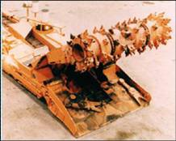
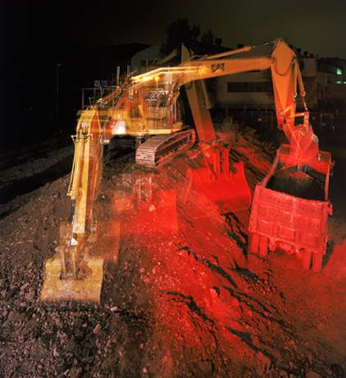
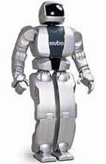
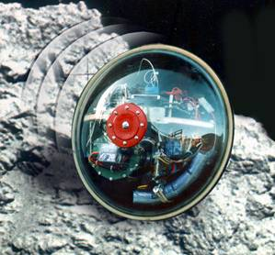
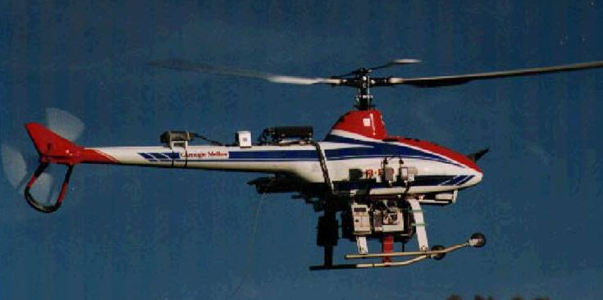
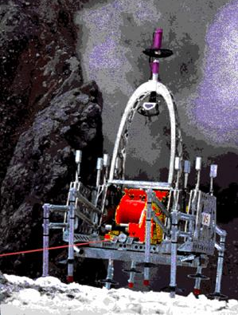
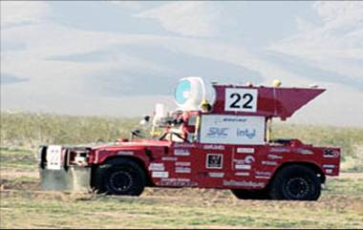
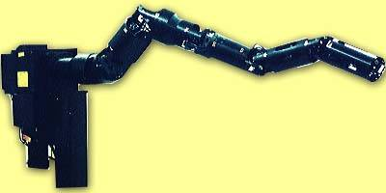
Many Different Types of Robots
Snake Robot
Notes:
Different Types of Robots (Discussion: include student examples)
Dangerous work, Dull (repetitive) work, Delicate (precision) work, Dirty work (hostile environments, beyond human capability), etc.

Slide 4
NXT Robotics Platform
NXT Hardware
NXT Firmware
NXT Software
Notes:
NXT: Our Robotics Technology of Choice
o Ask how many students have worked with Lego
§ Lego is the "manufacturer" of the NXT (first robot characteristic)
o Explain we will explore hardware vs firmware vs software in future lessons
§ Hardware – what you can touch
§ Software – instructions programmer (student) gives robot
§ Firmware – instructions manufacturer (Lego) gives robot
o We’ll be focusing on the hardware for the next few lessons

Slide 5
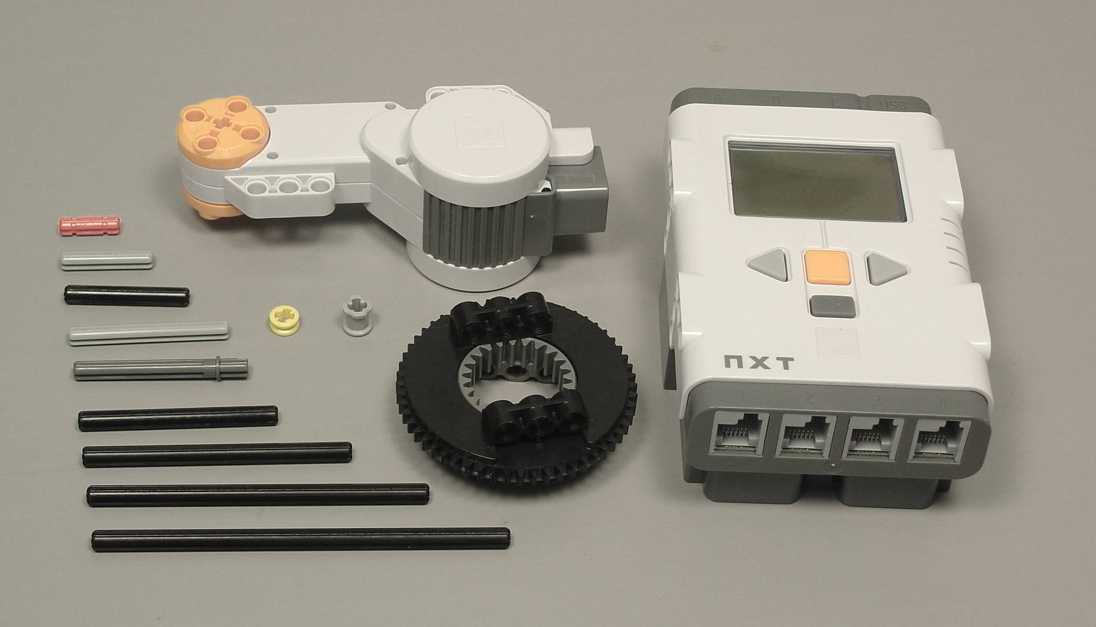
Building
LEGO® Pieces
Notes:
o Hardware includes tradition Lego building pieces plus NXT parts

Slide 6
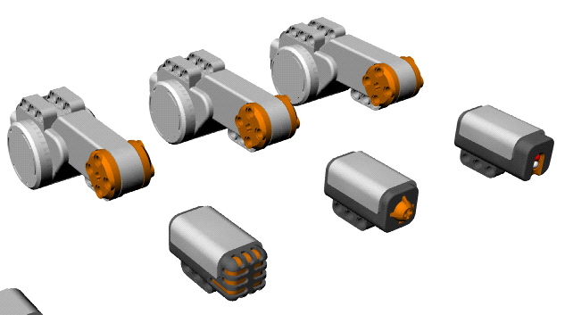
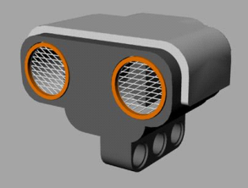
Building LEGO® Motors and Sensors
Motors
Light Sensor
Ultrasonic Sensor
Touch Sensor
Sound Sensor
Notes:
§ NXT sensors (light, touch, sound, ultrasonic)
· Have students compare these to human senses
· These are how NXT robots “sense their environment” (second robot characteristic)
§ NXT motors
· Have students compare these to human capabilities (muscles)
· These are one way NXT robots “respond to instructions” (third robot characteristic)

Slide 7
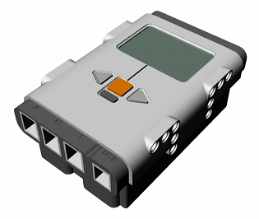
Building LEGO® NXT
LCD Display Screen
Sensor Input Ports
Motor Output Ports
Navigation Buttons
USB connection socket
Notes:
§ NXT “brick”
· Have students compare these to human capabilities (brain)
· Controls motors, lights and LCD screen based on instructions and sensory input

Slide 8
Lego: Not Just a Toy
Rubik’s Cube Solver (3:00)
  http://www.youtube.com/watch?v=5fAn5A0HbhU&feature=player_embedded#
CubeStormer II "The Ultimate Cube Solver” (3:08)
  http://www.youtube.com/watch?feature=player_detailpage&v=qTq2V1aPAp8
Lego Mindstorms Robots (5:20) http://www.youtube.com/watch?feature=player_detailpage&v=_lbp0ueqHFs
LEGO NXT Balancing Road TwoWheels Robot (4:37)
http://www.youtube.com/watch?feature=player_detailpage&v=-KQcUo3JVUs
Sudoku Solver (4:06)
  http://www.youtube.com/watch?v=Mp8Y2yjV4fU
Portrayer (1:42)
  http://www.youtube.com/watch?v=_ogQuLdEcBY&feature=player_embedded
Notes:
o NXT – Although Lego, not just a toy
§ Show video examples of Rubik’s Cube Solver, Sudoku Solver and Portrait drawing NXT
· Exact same hardware as students will use in class
· Point out brick, motors and sensors in videos
· More complex software than students will start with, but all within reach in advanced classes

